Slide 1
Module IV
Designing Remote Connectivity
Hous 09

Slide 2
This chapter discusses the WAN function that provides access to remote sites and the outside world. It details WAN technologies and WAN design considerations.
Enterprise Edge WAN Technologies
This section introduces the concept of the WAN, beginning with the definition of a WAN and the types of WAN interconnections. Various WAN technologies are described. The section concludes with a discussion of WAN pricing and contract considerations.
A WAN is a data communications network that covers a relatively broad geographic area. A WAN typically uses the transmission facilities provided by service providers (SP) (also called carriers), such as telephone companies.

Slide 3
Designing a WAN is a challenging task. The first design step is to understand the WAN’s networking requirements, which are driven by two primary goals:
Service level agreement (SLA): Networks carry application information between computers. If the applications are not available to network users, the network fails to achieve its design objectives. Organizations need to define the level of service, such as bandwidth, allowed latency, packet loss, and so forth, that is acceptable for the applications running across the WAN.
Cost of investment and usage: WAN designs are always subject to budget limitations. Selecting the right type of WAN technology is critical to providing reliable services for enduser applications in a cost-effective and efficient manner.
Flowing from these goals are the following objectives of an effective WAN design:
A well-designed WAN must reflect the goals, characteristics, and policies of an organization.
The selected WAN technology should be sufficient for current and, to some extent, future application requirements.
The associated costs of investment and usage should stay within the budget limits.

Slide 4
WAN technologies connect the Enterprise Edge modules
with the outside world, represented by the service provider network. Typically, the intent is to
provide the following connections:
Connectivity between the Enterprise Edge modules and the Internet Service Provider (ISP)
Edge module
Connectivity between Enterprise sites across the ISP network
Connectivity between Enterprise sites across the SP or public switched telephone network
(PSTN) carrier network
WAN connections can be point-to-point between two locations or connections to a multipoint
WAN service offering, such as a Frame Relay or Multiprotocol Label Switching (MPLS) network.

Slide 5
Traditional WAN Technologies
Leased lines: Point-to-point connections indefinitely reserved for transmissions, rather than
used only when transmission is required. The carrier establishes the connection either by
dedicating a physical wire or by delegating a channel using frequency division multiplexing
or time-division multiplexing (TDM). Leased-line connections usually use synchronous
transmission.
Circuit-switched networks: A type of network that, for the duration of the connection,
obtains and dedicates a physical path for a single connection between two network endpoints.
Ordinary voice phone service over the PSTN is circuit-switched; the telephone company
reserves a specific physical path to the number being called for the call’s duration. During that
time, no one else can use the physical lines involved. Other circuit-switched examples include
asynchronous serial transmission and ISDN.
Packet-switched and cell-switched networks: A carrier creates permanent virtual circuits
(PVC) or switched virtual circuits (SVC) that deliver packets of data among customer sites.
Users share common carrier resources and can use different paths through the WAN (for
example, when congestion or delay is encountered).

Slide 6
WAN Design
The methodology espoused here follows the guidelines of the Prepare-Plan-Design-Implement- Operate-Optimize (PPDIOO) methodology introduced in Chapter 2, “Applying a Methodology to Network Design.” The network designer should follow these steps when planning and designing the Enterprise Edge based on the PPDIOO methodology:
Step 1 Analyzing customer requirements: The initial step in the design methodology is to analyze the requirements of the network and its users, including the type of applications, the traffic volume, and traffic patterns. User needs continually change in response to changing business conditions and changing technology. For example, as more voice and video-based network applications become available, there is pressure to increase network bandwidth.
Step 2 Characterizing the existing network and sites: The second step is to analyze the existing networking infrastructure and sites, including the technology used and the location of hosts, servers, terminals, and other end nodes. Together with the network’s physical description, the analysis should evaluate the possibility of extending the network to support new sites, new features, or the reallocation of existing nodes. For example, the future integration of data and telephone systems requires considerable changes in the network’s configuration. In this case, a detailed evaluation of current options is important.

Slide 7
Step 3 Designing the network topology and solutions: The final step in the design methodology is to develop the overall network topology and its appropriate services, based on the availability of technology, and taking into account the projected traffic pattern, technology performance constraints, and network reliability. The design document describes a set of discrete functions performed by the Enterprise Edge modules and the expected level of service provided by each selected technology, as dictated by the SP.

Slide 8
Wireless Technologies
With wireless technologies, networks do not have the limitations of wires or cables; instead, electromagnetic waves carry the RF signals.
Common examples of wireless equipment include cellular phones and pagers, global positioning systems, cordless computer peripherals, satellite television, and wireless LANs (WLAN).

Slide 9
Application Requirements of WAN Design
Response Time
Response time is the time between a user request (such as the entry of a command or keystroke) and the host system’s command execution or response delivery.
Throughput
In data transmission, throughput is the amount of data moved successfully from one place to another in a given time period.
Packet Loss
In telecommunication transmission, packet loss is expressed as a bit error rate (BER), which is the percentage of bits that have errors, relative to the total number of bits received in a transmission.
Reliability

Slide 10
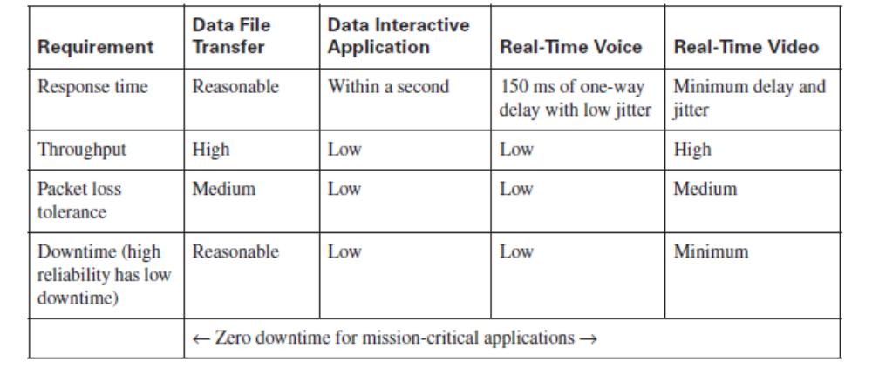

Slide 11
Technical Requirement
Maximum Offered Traffic
The goal of every WAN design should be to optimize link performance in terms of offered traffic, link utilization, and response time. To optimize link performance, the designer must balance between end-user and network manager requirements, which are usually diametrically opposed.
End users usually require minimum application response times over a WAN link, whereas the network manager’s goal is to maximize the link utilization; WAN resources have finite capacity.
Users perceive the data processing experience in terms of how quickly they can get their screen to update. They view the data processing world in terms of response time and do not usually care about link utilization.

Slide 12
Bandwidth
Bandwidth is the amount of data transmitted or received per unit time, such as 100 Mbps.
For example, downloading a photograph in 1 second takes more bandwidth than downloading a page of text in 1 second.
Large sound files, computer programs, and animated videos require even more bandwidth for acceptable system performance.
One of the main issues involved in WAN connections is the selection of appropriate technologies that provide sufficient bandwidth.

Slide 13
Evaluating the Cost-Effectiveness of WAN Ownership
In the WAN environment, the following usually represent fixed costs:
■ Equipment purchases, such as modems, channel service unit/data service units, and router
interfaces
■ Circuit and service provisioning
■ Network-management tools and platforms
Recurring costs include the monthly circuit fees from the SP and the WAN’s support and
maintenance, including any network management center personnel.
From an ownership perspective, WAN links can be thought of in the following three categories:

Slide 14
Private:
A private WAN uses private transmission systems to connect distant LANs.
The owner of a private WAN must buy, configure, and maintain the physical layer connectivity (such as copper, fiber, wireless, and coaxial) and the terminal equipment required to connect locations.
This makes private WANs expensive to build, labor-intensive to maintain, and difficult to reconfigure for constantly changing business needs. The advantages of using a private WAN might include higher levels of security and transmission quality.
Leased:
A leased WAN uses dedicated bandwidth from a carrier company, with either private or leased terminal equipment.
The provider provisions the circuit and provides the maintenance.
However, the company pays for the allocated bandwidth whether or not it is used, and operating costs tend to be high. Some examples include TDM and SONET circuits.

Slide 15
Shared:
A shared WAN shares the physical resources with many users.
Carriers offer a variety of circuit- or packet-switching transport networks, such as MPLS and Frame Relay.
The provider provisions the circuit and provides the maintenance

Slide 16
Optimizing Bandwidth in a WAN
It is expensive to transmit data over a WAN. Therefore, one of many different techniques—such as data compression, tuning window size, congestion management (queuing and scheduling), congestion avoidance, and traffic shaping and policing—can be used to optimize bandwidth usage and improve overall performance.
Compression is the reduction of data size to save transmission time.
Window size is the maximum number of frames (or amount of data) the sender can transmit before it must wait for an acknowledgment.
QoS does not create bandwidth; rather, QoS optimizes the use of existing resources, including bandwidth.
Queuing is configured on outbound interfaces and is appropriate for cases in which WAN links are congested from time to time.
Congestion-avoidance techniques allow packets from streams identified as being eligible for early discard (those with lower priority) to be dropped when the queue is getting full.

Slide 17
Policing either discards the packet or modifies some aspect of it, such as its IP precedence,
when the policing agent determines that the packet meets a given criterion.

Slide 18
Using WAN Technologies
Numerous WAN technologies exist today, and new technologies are constantly emerging. The most appropriate WAN selection usually results in high efficiency and leads to customer satisfaction.
The network designer must be aware of all possible WAN design choices while taking into account customer requirements. This section describes the use of various WAN technologies, including the following:
■ Remote access
■ VPNs
■ WAN backup
■ The Internet as a backup WAN

Slide 19
Remote Access Network Design
When you’re designing remote-access networks for teleworkers and traveling employees, the type of connection drives the technology selection, such as whether to choose a data link or a network layer connection.
By analyzing the application requirements and service provider offerings, you can choose the most suitable of a wide range of remote-access technologies. Typical remoteaccess requirements include the following:
Data link layer WAN technologies from remote sites to the Enterprise Edge network. Investment and operating costs are the main issues.
Low- to medium-volume data file transfer and interactive traffic.
Increasing need to support voice services.
Remote-access technology selections include dialup (both analog and digital), DSL, cable

Slide 20
WAN Backup Strategies
This section describes various backup options for providing alternative paths for remote access.
WAN links are relatively unreliable compared to LAN links and often are much slower than the
LANs to which they connect. This combination of uncertain reliability, lack of speed, and high
importance makes WAN links good candidates for redundancy to achieve high availability.
Branch offices should experience minimum downtime in case of primary link failure. A backup
connection can be established, either via dialup or by using permanent connections. The main
WAN backup options are as follows:
■ Dial backup routing
■ Permanent secondary WAN link
■ Shadow PVC

Slide 21
Shadow PVC
With shadow PVCs, as long as the maximum load on the shadow PVC does not exceed a certain rate (such as one-fourth of the primary speed) while the primary PVC is available, the SP provides a secondary PVC without any additional charge. If the traffic limit on the shadow PVC is exceeded while the primary PVC is up, the SP charges for the excess load on the shadow PVC.

Slide 22
Enterprise Edge WAN and MAN Architecture
Recall from Chapter , “Structuring and Modularizing the Network,” that the Cisco Service-
Oriented Network Architecture (SONA) Enterprise Edge and the WAN and MAN modules are
represented as the Enterprise Edge functional area of the Cisco Enterprise Architectures.
Enterprise Edge WAN and MAN Considerations
When selecting Enterprise Edge technologies, consider the following factors:
Support for network growthAppropriate availability
Operational expenses
Operational complexity
Voice and video support
Effort and equipment cost to migrate from private connectivity
Network segmentation suppor

Slide 23
Enterprise Branch and Teleworker Design
Recall that the Cisco Enterprise Architecture, based on the Cisco SONA, includes branch modules that focus on the remote places in the network. Enterprises are seeking opportunities to protect, optimize, and grow their businesses by increasing security; consolidating voice, video, and data onto a single IP network; and investing in applications that will improve productivity and operating efficiencies. These services provide enterprises with new opportunities to reduce costs, improve productivity, and safeguard information assets in all their locations.

Slide 24
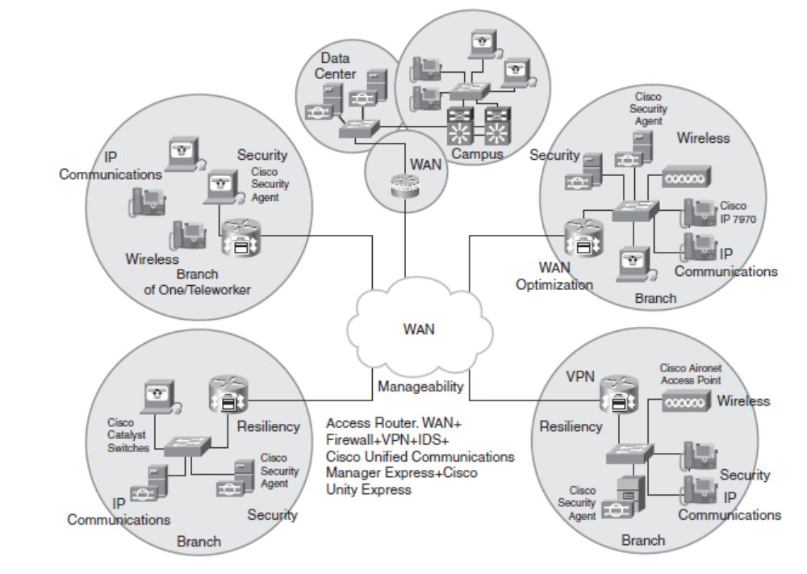

Slide 25
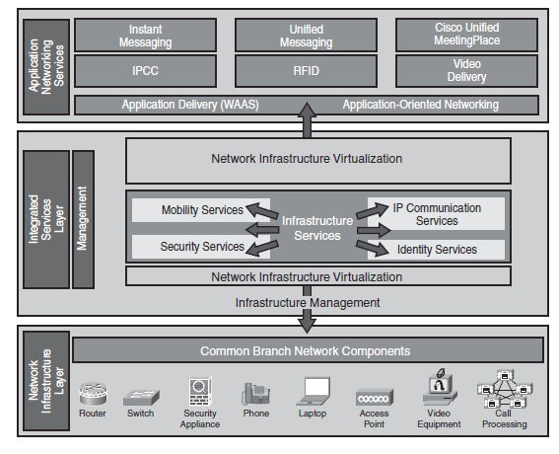

Slide 26
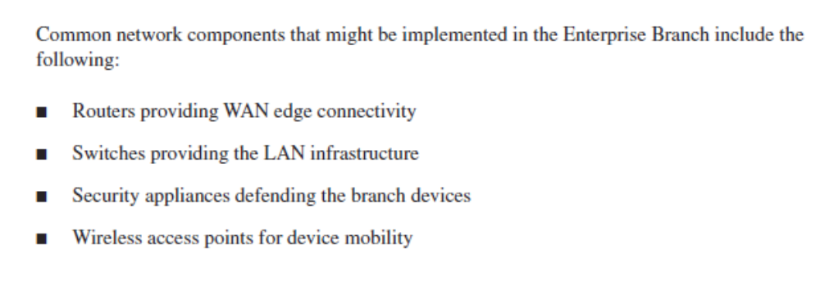

Slide 27
Enterprise Branch Design
Requirements differ with the size of the branch offices. Consider to the following questions when
designing the Enterprise Branch:
■ How many branch locations need to be supported?
■ How many existing devices (including end users, hosts, and network infrastructure) are to be supported at each location? The number of devices supported is limited by the physical number of ports available.
■ How much growth is expected at each location, and therefore what level of scalability is required?
■ What are the high availability requirements at each location?
■ What level of security is required in the design? Should security be managed locally or through the central location?
■ Are there any requirements for local server farms or networks between the internal network and the external network (for example, in a demilitarized zone [DMZ])?
■ Should network management be supported locally or via the central location?
■ What wireless services are needed, and how will they be used by the clients? What effect will the network and the environment have on the wireless devices?
■ What is the approximate budget available?

Slide 28
